Slide 1



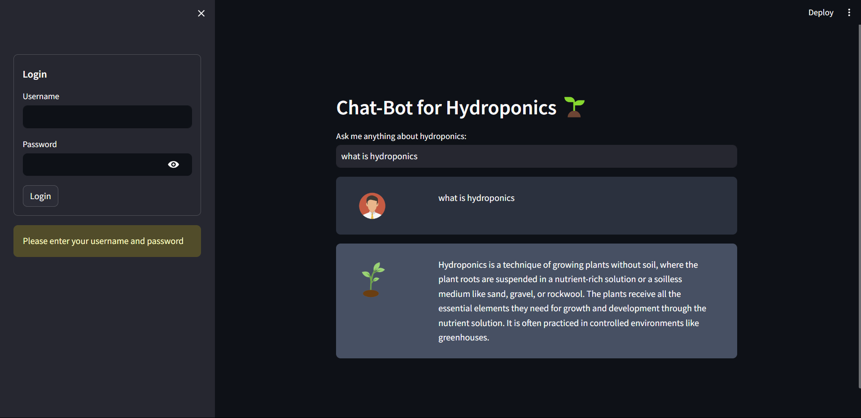
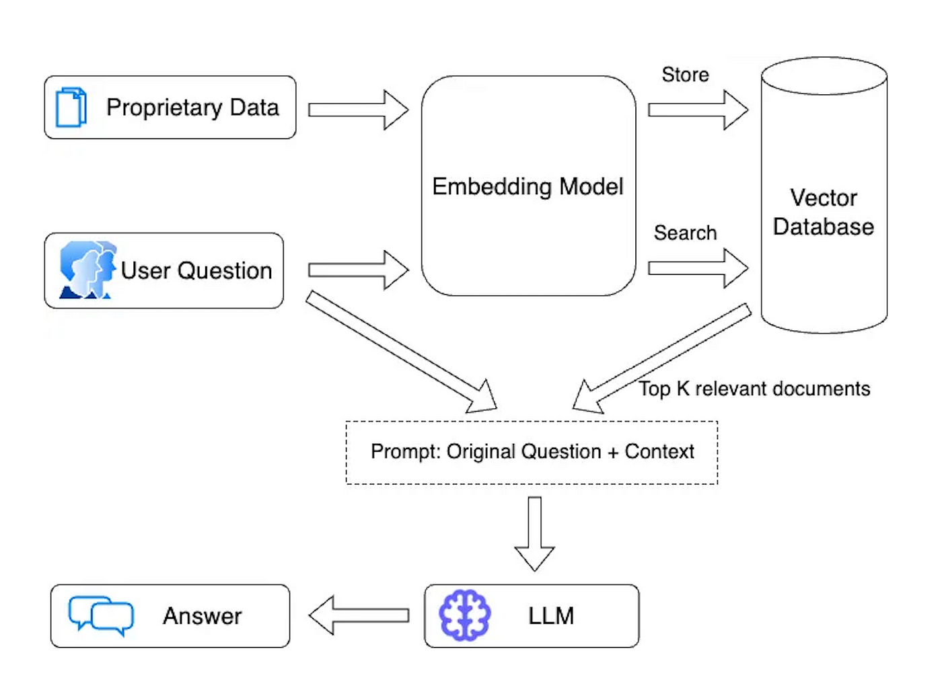
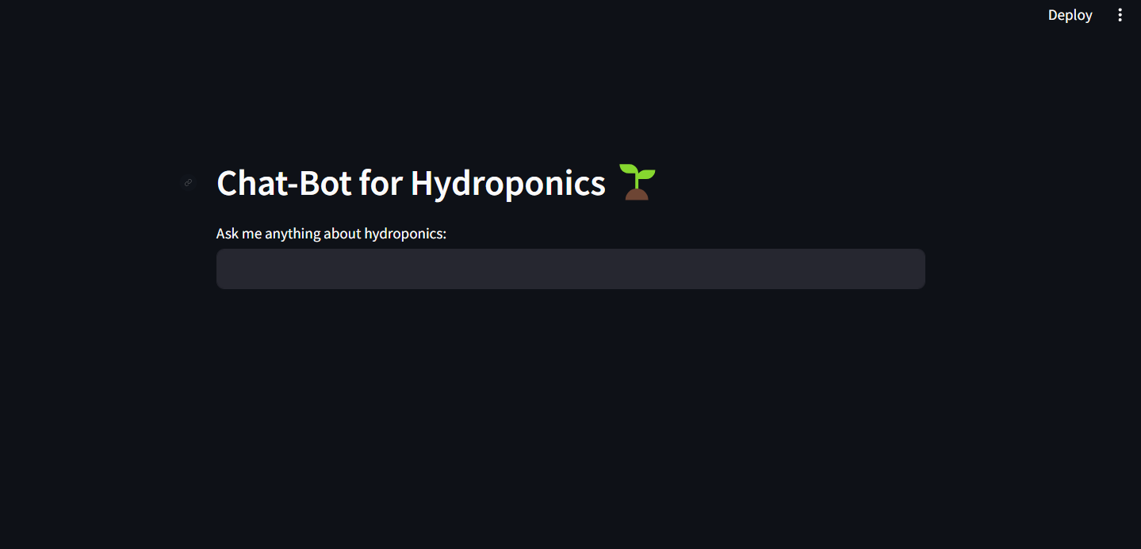
“Chat Bot for Hydroponics”
Department of Computer Science & Engineering
School of Computing
10214CS602– MINOR PROJECT-2
WINTER SEMESTER 2023-2024
ABSTRACT
INTRODUCTION
RESULTS
STANDARDS AND POLICIES
This paper explores the potential of chatbots in revolutionizing hydroponic gardening practices. Chatbots, powered by artificial intelligence and natural language processing, offer personalized assistance and troubleshooting support to hydroponic enthusiasts. By leveraging real-time monitoring and machine learning algorithms, chatbots can provide tailored recommendations and expert advice to optimize plant growth and health. However, successful implementation requires adherence to standards and policies related to privacy, security, ethics, and user satisfaction.
Revolutionizing the way you engage with hydroponic gardening. Designed to cater to both novice growers and seasoned enthusiasts, This chatbot harnesses the power of artificial intelligence and natural language processing to provide personalized guidance, troubleshooting support, and expert advice at your convenience. With This chatbot, accessing comprehensive knowledge on hydroponic techniques, nutrient management, and plant care is just a conversation away. Whether you're monitoring pH levels, diagnosing plant issues, or seeking cultivation tips, This chatbot tailors its responses to your unique setup and requirements. Stay informed with real-time monitoring and receive actionable insights to optimize plant growth and health.
Privacy Policy: Develop a clear and transparent privacy policy outlining how user data is collected, stored, used, and protected by the chatbot. Ensure compliance with relevant data protection regulations, such as GDPR (General Data Protection Regulation) and provide users with options to control their data preferences.
Security Standards: Implement robust security measures to safeguard user data and prevent unauthorized access, disclosure, or misuse. This may include encryption, access controls, secure authentication mechanisms, and regular security assessments and audits.
CONCLUSIONS
In summary, chatbots offer an exciting way to improve hydroponic gardening by providing personalized assistance and troubleshooting. To ensure success, it's crucial to prioritize privacy, security, ethics, and user satisfaction. With these considerations in mind, chatbots have the potential to revolutionize how growers manage their hydroponic systems, making gardening more accessible and efficient for everyone involved. As the field of hydroponics continues to evolve, chatbots have the potential to become indispensable tools for empowering growers, optimizing plant health, and advancing sustainable agriculture practices for the benefit of individuals, communities, and the environment alike.
METHODOLOGIES
Natural Language Processing (NLP): Implement NLP algorithms to enable the chatbot to understand and interpret user queries and responses in natural language. This involves techniques such as tokenization, part-of-speech tagging, named entity recognition, and sentiment analysis.
Knowledge Base Development: Create a comprehensive knowledge base comprising information on hydroponic techniques, plant care, nutrient management, troubleshooting guides, and best practices.
Machine Learning (ML): Utilize machine learning algorithms to improve the chatbot's performance over time. Train the chatbot on user interactions and feedback data to enhance its understanding, responsiveness, and ability to provide personalized assistance.
TEAM MEMBER DETAILS
VTU19464 AMAN CHINMAI DEV
VTU19486 E. SOWMIYA
VTU19347 SHREYA TIGGA
9059432169
9363293327
9679504888
vtu19464@veltech.edu.in
vtu19486@veltech.edu.in
vtu19347@veltech.edu.in
ACKNOWLEDGEMENT
Dr. T. KAMALESHWAR, M.Tech., Ph.D.,
ASSOCIATE PROFESSOR
99946 14463
dtrkamaleshwar@veltech.edu.in

